Slide 1
Hero of Coloria
Jesus Chavez

Slide 2
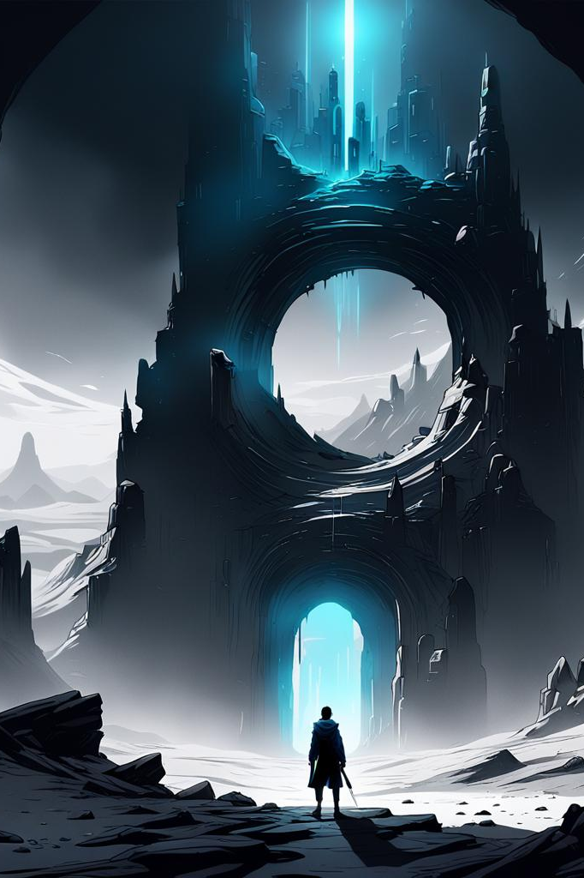
Pix was an inquisitive point of light that resided in Coloria, a colorful place. A mysterious portal suddenly materialized in the city's center one day. Pix entered the portal, drawn by its allure, and discovered himself in an odd, monochrome world.

Slide 3
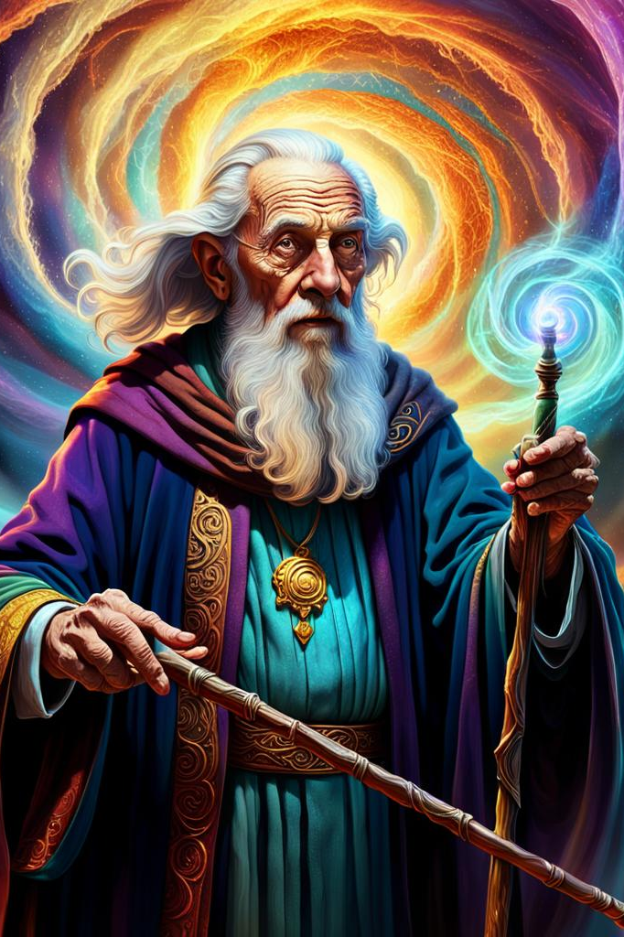
Pix was lost and confused as he made his way through the monochromatic landscape until he came upon an elderly color wizard who was wise. The wizard revealed that Coloria was left in this monochromatic state because a formidable color thief had taken all of the colors out of the planet.

Slide 4
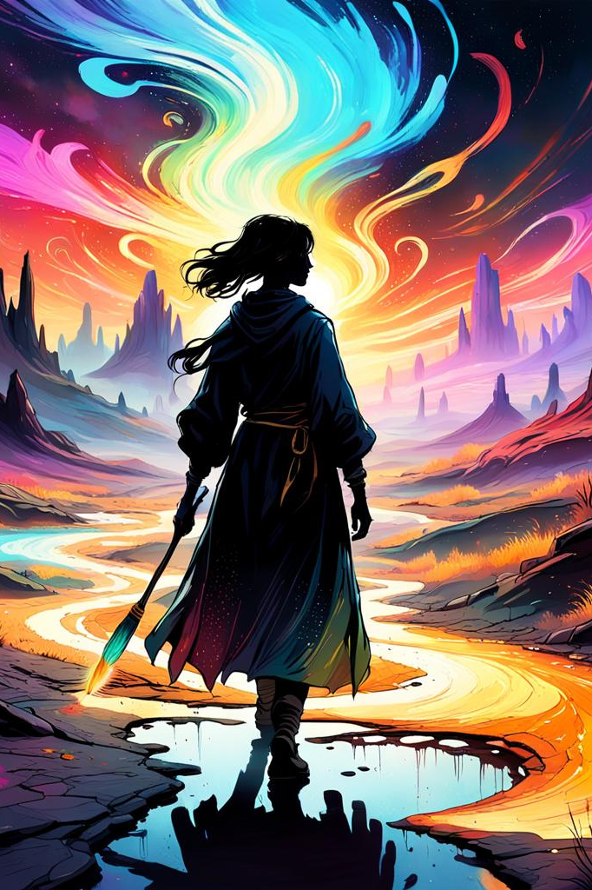
The wizard gave Pix a magical paintbrush that could bring back color. Pix embarked on a perilous mission to track down the color thief and bring back the stolen hues to Coloria, driven by a renewed sense of resolve.

Slide 5
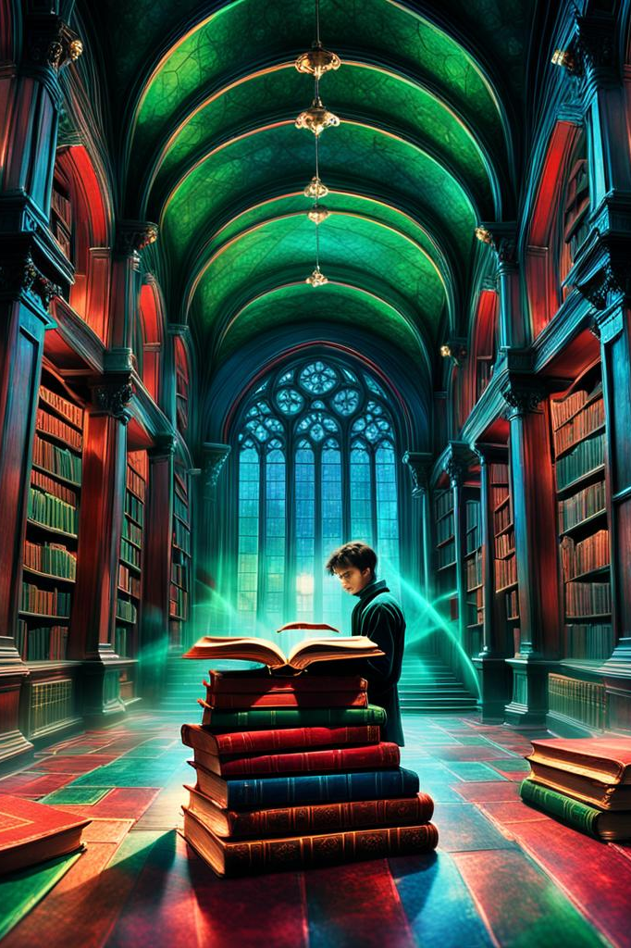
He encountered Red, Green, and Blue en route. They described their collaborative process for producing millions of colors. After that, Pix went to HSV and met Hue, Saturation, and Value. They demonstrated to him how to more naturally adjust color.

Slide 6
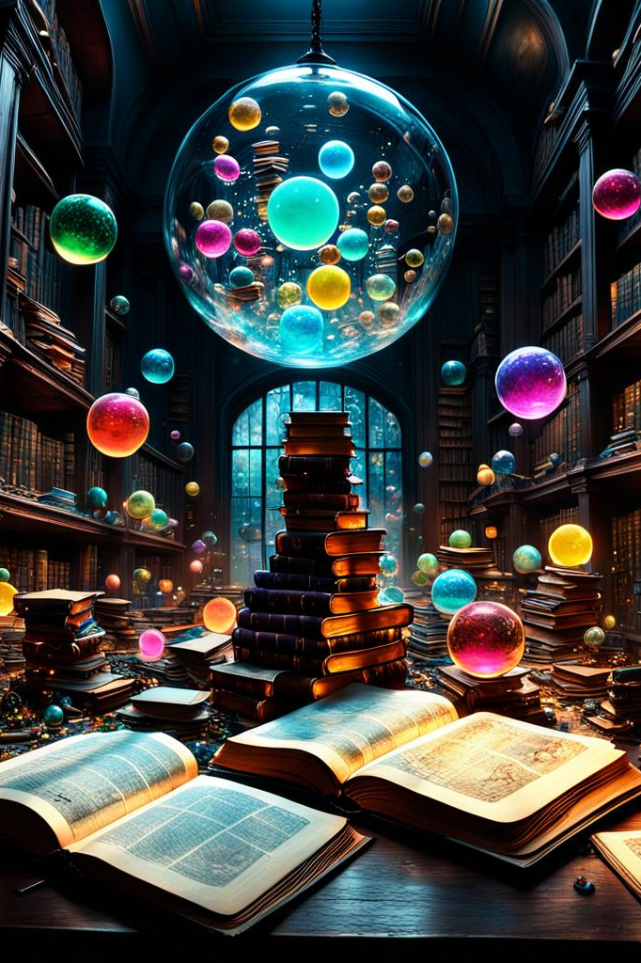
Pix came across numerous additional color models on his travels, each with special traits and applications. He was introduced to the printing-related CMYK, the color-correction-related Lab, and the HSL(which is comparable to HSV but uses a different value scale).

Slide 7
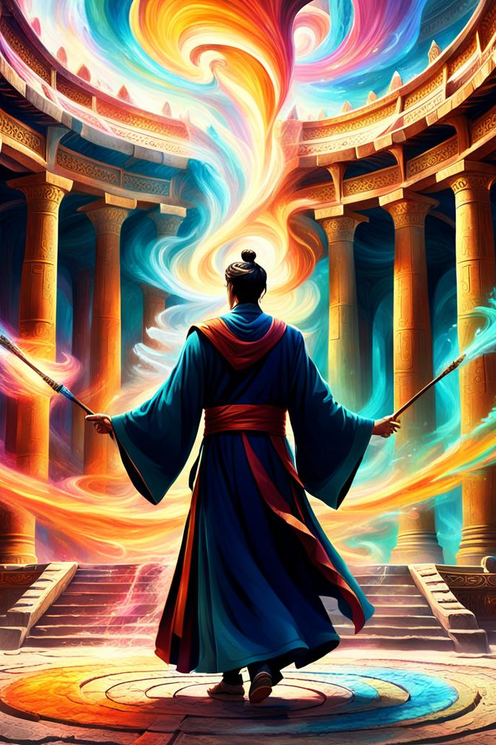
Pix gained additional knowledge about the significance and potency of color in the world. At last, he faced the elusive individual who had pilfered the colors and kept them for himself—the color thief. Pix defeated the thief and released the stolen colors after a fierce battle in which he used the magical paintbrush to unleash a dazzling array of colors.

Slide 8
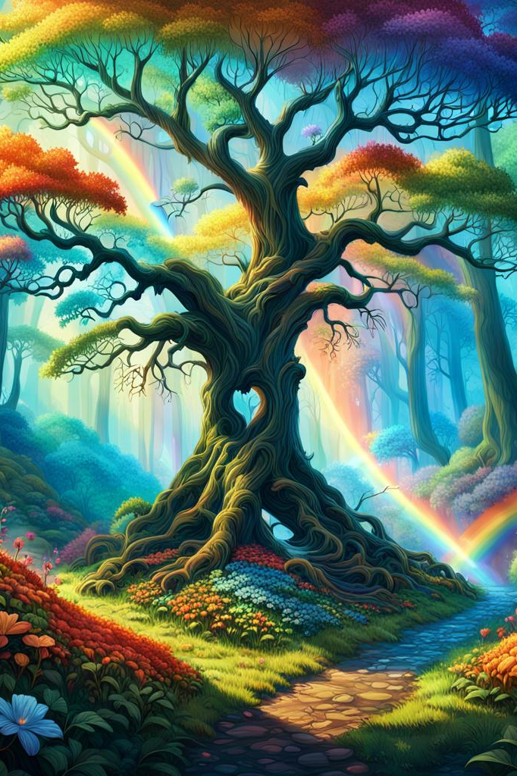
The world turned into a vivid and lovely place once more as the colors returned to Coloria. After saving Coloria, Pix was greeted as a hero and went back home with a profound understanding of the power and magic of color.

Slide 9
This adventure quest was an excellent way to explore the field of image processing in a fun and interesting way. I had a lot of fun investigating the Color Models and Pixel Realm. It was enlightening to learn about the various color models (RGB, HSV, CMYK) and how images are represented using them. Finding out about the distinctions between additive and subtractive color models and their various applications startled me. Writing a story about Pix was a fun and thought-provoking challenge. It pushed me to consider original ways to explain difficult technical ideas in a way that was interesting and approachable. I discovered that I could make the various color models more approachable and understandable by giving them personalities. I now have a greater understanding of the fundamental ideas behind digital images and the significance of color in both their creation and perception thanks to this experience. In addition, I improved my storytelling abilities and discovered new ways to effectively convey technical knowledge to a larger audience.

